Slide 1
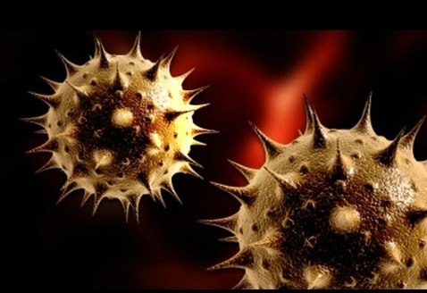
History of Biological Weapons
Dr NaserAli Al-Ansari
Consultant Medical Microbiologist & Infection Control
Al Wakra Hospital - HMC
Qatar

Slide 2
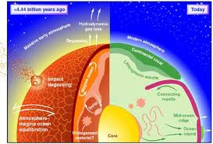
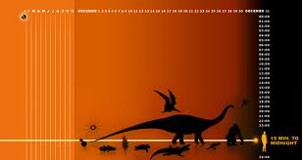
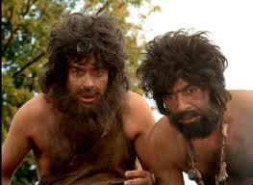
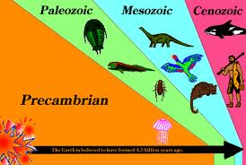
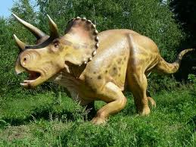
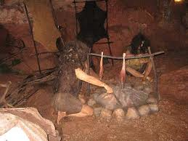

Slide 3
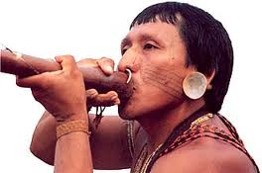
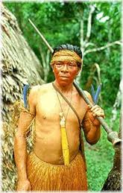
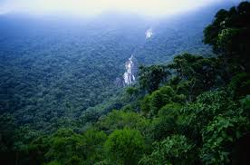
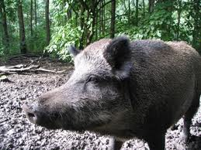
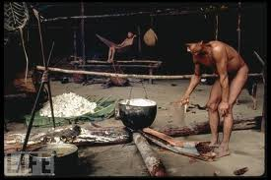

Slide 4
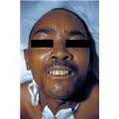
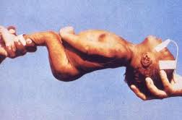
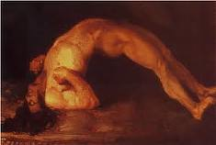
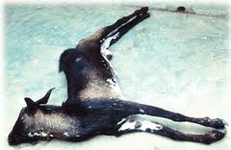
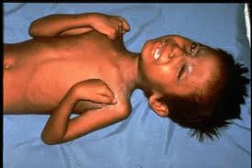
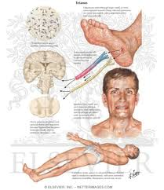
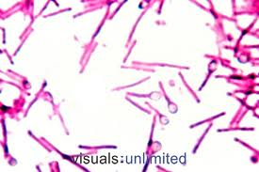
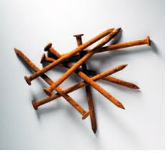

Slide 5
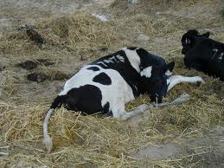
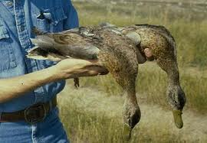
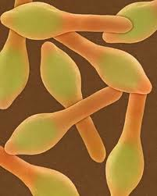
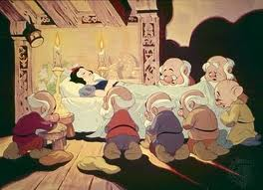
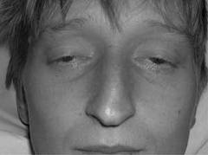
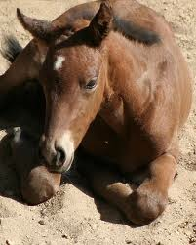

Slide 6
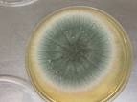
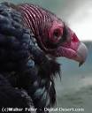
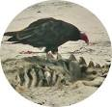

Slide 7
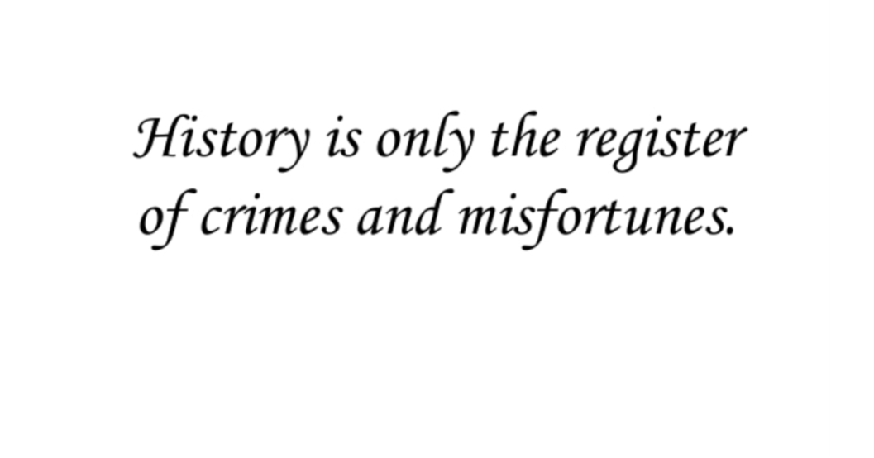

Slide 10
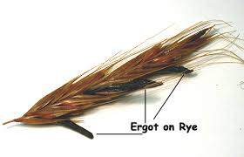
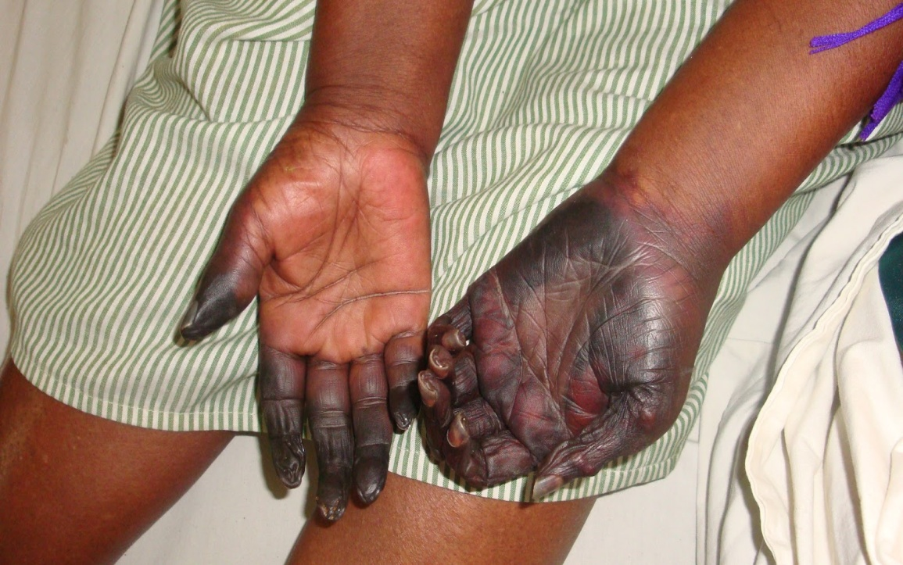
Assyrians

Slide 11
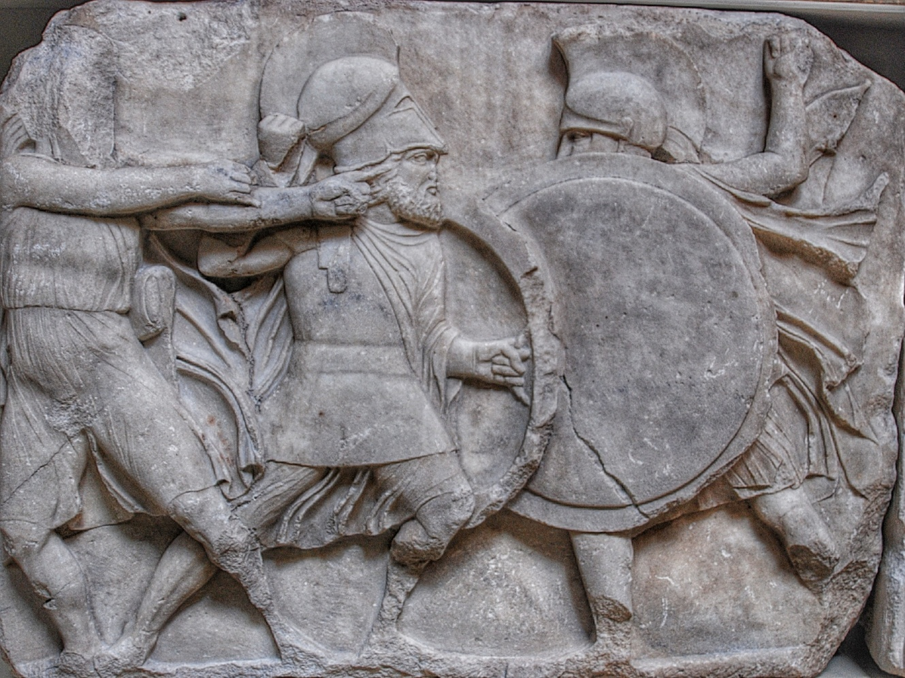
Greeks poisoning the water of Kirrha using hellebore
During the Siege of Kirrha in 585 BC, hellebore was reportedly used by the Greek besiegers to poison the city's water supply. The defenders were subsequently so weakened by diarrhea that they were unable to defend the city from assault

Slide 12
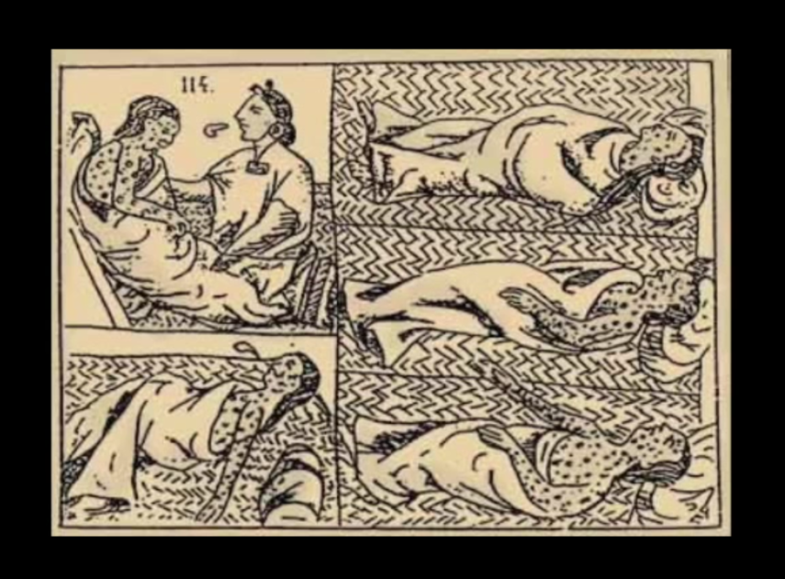
The Aztec

Slide 13
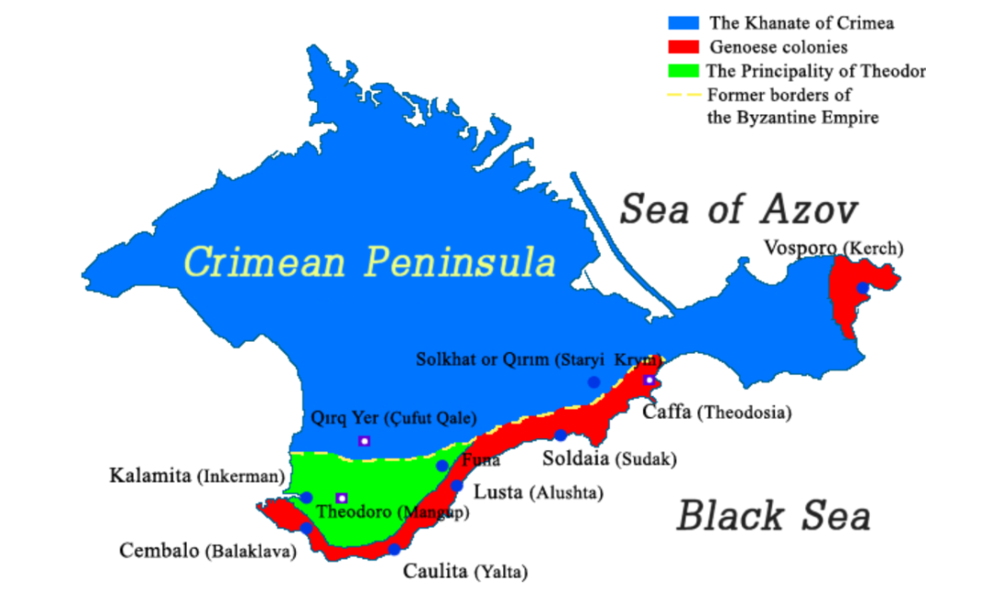

Slide 14
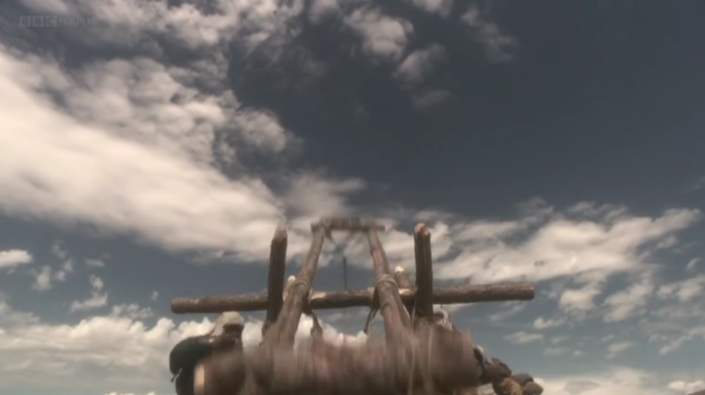
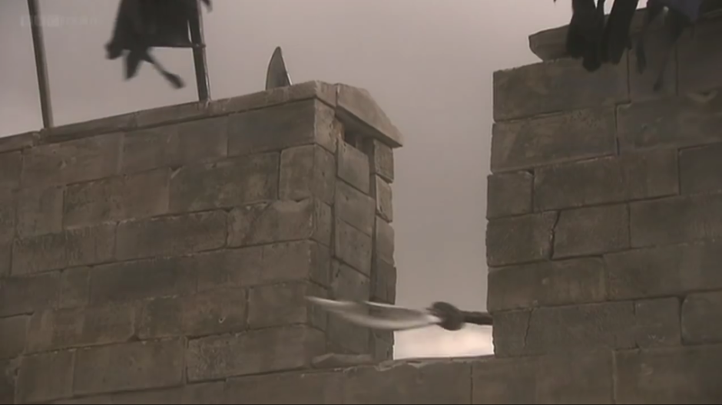
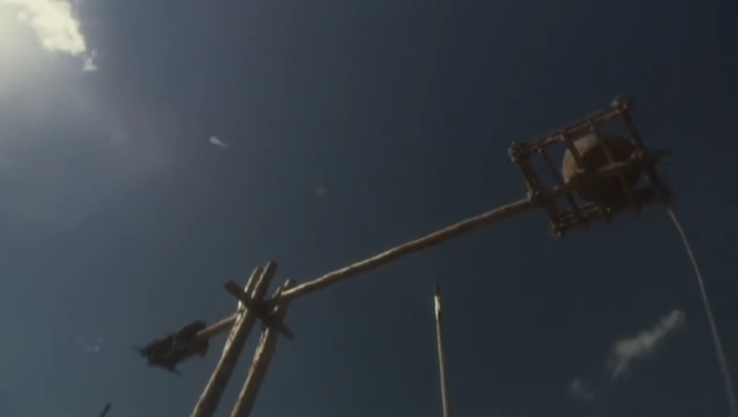
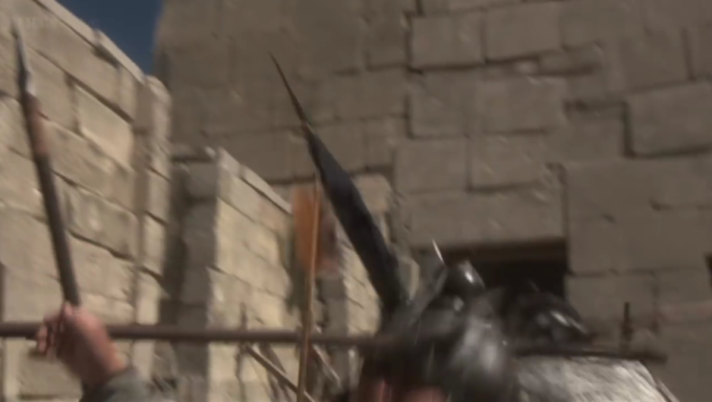

Slide 15
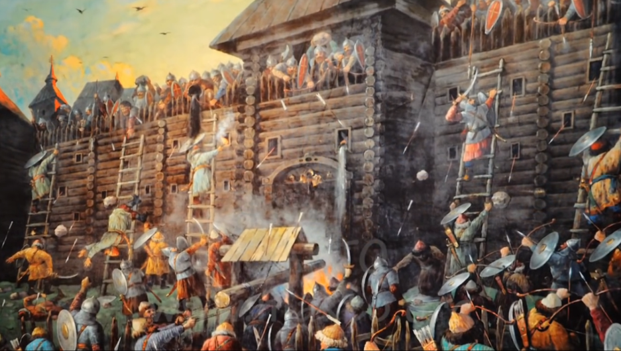
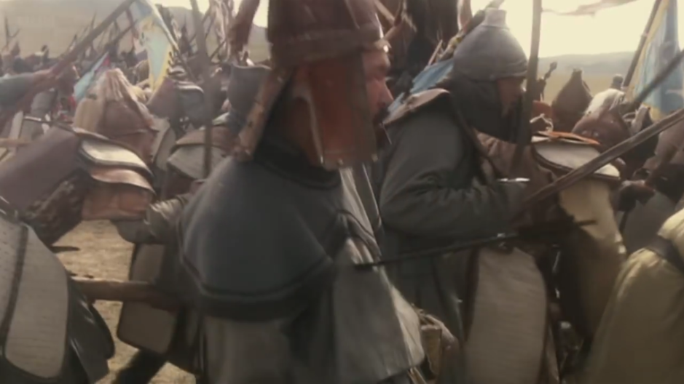
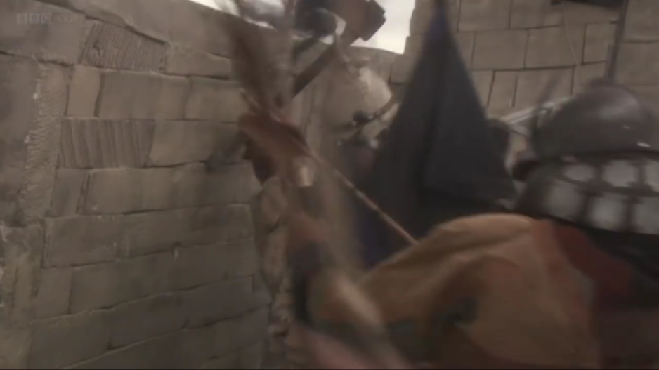
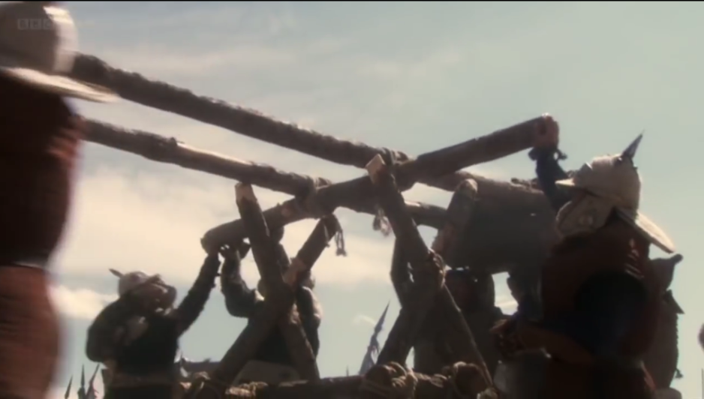

Slide 16
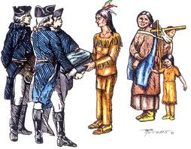
BRITISH WAR WITH THE NATIVE AMERICANS

Slide 17
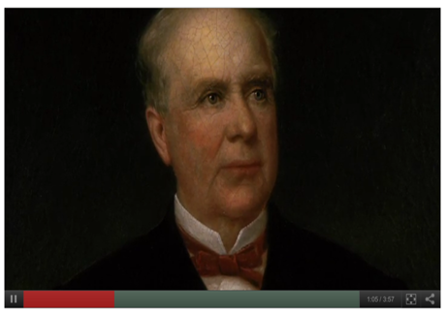
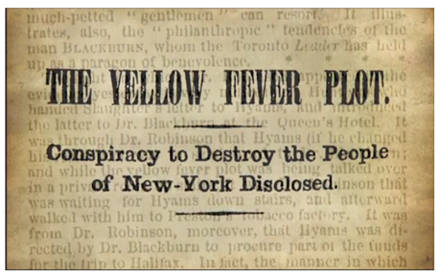

Slide 18
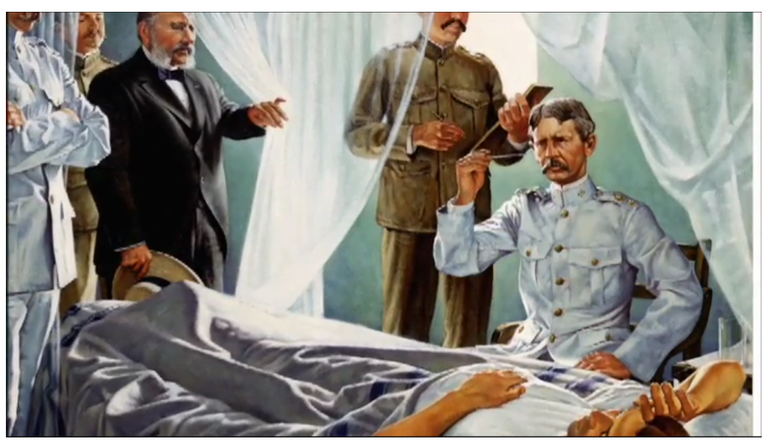
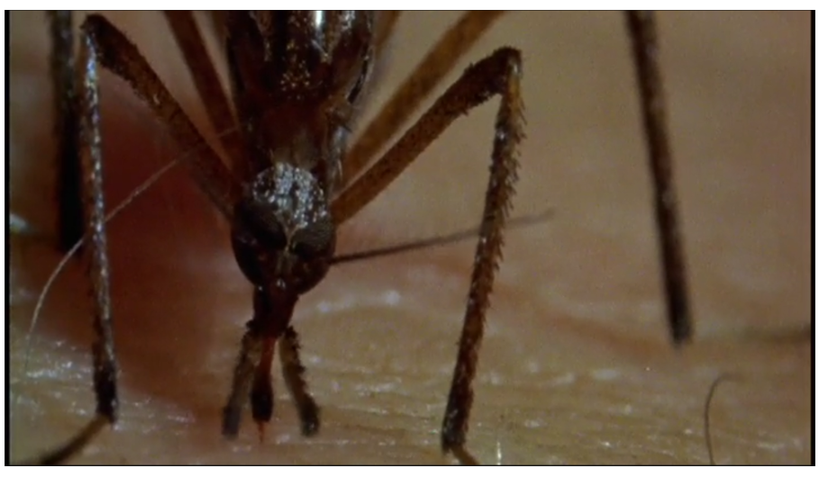
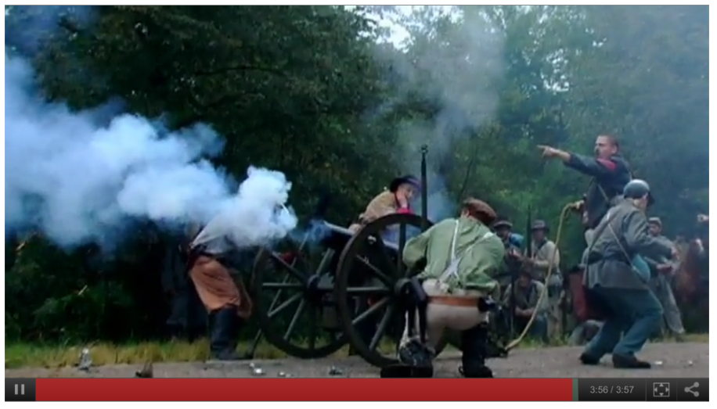

Slide 19
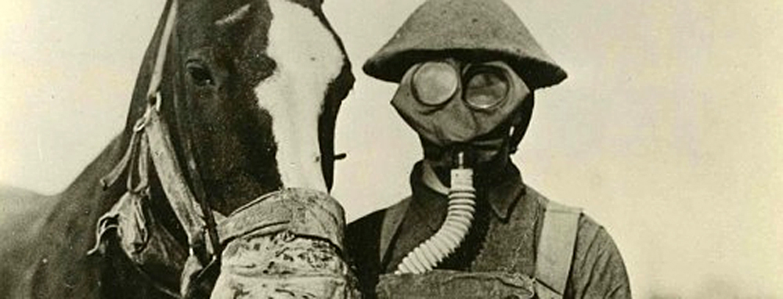
WORLD WAR I THROUGH 1945

Slide 20
THE BRITISH ANTHRAX DEVELOPMENT

Slide 21
Peter Williams & David Wallace (1989), Unit 731: Japan's Secret Biological Warfare in World War II, Free Press, ISBN 0-02-935301-7

Slide 22
1945 THROUGH 1972

Slide 28
1925 Geneva Protocol
The Protocol for the Prohibition of the Use in War of Asphyxiating, Poisonous or other Gases, and of Bacteriological Methods of Warfare)
The Convention on the Prohibition of the Development, Production and Stockpiling of Bacteriological (Biological) and Toxin Weapons and on their Destruction
opened for signature on April 10, 1972
entered into force March 26, 1975
بروتوكول جنيف1925
حظر استخدام الغازات الخانقة أو السامة او غيرها
اتفاقية حظر استحداث وإنتاج وتخزين الأسلحة الجرثومية (البيولوجية) والسمية وتدميرها
فتح باب التوقيع في 10 نيسان 1972
دخل حيز التنفيذ 26 اذار/مارس 1975

Slide 29
Verification measures تدابير التحقق
أنشئ فريق الخبراء الحكوميين في المؤتمر الاستعراضي الثالث (1991 ) لتحديد و دراسة تدابير التحقق المحتملة من وجهة نظر علمية وتقنية
سبتمبر 1994 ، الفريق المخصص للتفاوض وتطوير نظام للتحقق ملزم قانونا لاتفاقية
لم يتمكن من أختتام المفاوضات بشأن مشروع صك قانوني ( بروتوكول ) الفريق المخصص 2001
قرار نوفمبر 2002 لعقد الاجتماعات السنوية للدول الأطراف والخبراء
• a group of governmental experts (VEREX) was established at the Third Review Conference (1991) to identify and examine potential verification measures from a scientific and technical standpoint.
• September 1994, Ad Hoc Group to negotiate and develop a legally-binding verification regime for the Convention.
• 2001. The Ad Hoc Group was unable to conclude the negotiations on the draft legal instrument (protocol).
• November 2002 decision to hold annual meetings of States parties and experts

Slide 30
•Legvold, R (2012). "The Soviet Biological Weapons Program: A History". Foreign Affairs 91 (6): 184–185.
•Zilinskas, R.A., "Iraq’s Biological Weapons: The Past as Future?", Journal of the American Medical Association, 1997;278:418–424, 60.
•NTI: Country Overviews: Israel: Biological Chronology
•Chandré Gould, Peter I. Folb: Project Coast: Apartheid's Chemical and Biological Warfare Programme, United Nations Publications, 2002 ISBN 9290451440

Slide 31
Aerosolization of Bacillus anthracis and botulinum toxin by Aum Shinrikyo

Slide 32
Bhagwan Rajneeshees – 1984
Contaminated restaurant salad bars
in The Dalles, Oregon with
salmonella spp. bacteria

Slide 33
In 1995, Larry Wayne Harris was arrested after receiving three vials of Yersinia pestis from the American Type Culture Collection under false pretenses
Notes:
33

Slide 34
ANTHRAX AS A BIOLOGICAL WEAPON

Slide 35
Global outbreaks of emerging and reemerging infectious disease present a growing threat to international security
ظهور الأمراض المتفشية و اللأمراض المستجدة المعدية عالميا تشكل تهديدا متزايدا للأمن الدولي
SARS virus
Viable and virulent organisms are stored and used in more legitimate bioscience facilities across the globe than ever before
كثرة المختبرات التي تتعامل مع الكائنات الحيوية المضرة في جميع أنحاء العالم
Individuals with the expertise necessary to misuse biology can be found in nearly all areas of the life sciences internationally
ازدياد عدد الخريجين في مجال علم الاحياء الدقيقة (الميكروبيولوجي)

